Slide 1
Indian agriculture analysis by: Khyati trivedi

Slide 2
agenda
Introduction
Data importation and preparation
Problem statement
conclusion

Slide 3
introduction
In agriculture sector, the farmers and agro based industries have to take several decisions every day and there are various factors that influence them. Some of the factors on which agriculture depends are soil, climate, cultivation, irrigation, fertilizers, temperature, rainfall, harvesting and use of pesticides. Mining the large amount of existing crop, soil and climatic data and analyzing the environmental conditions can make it possible for farmers to use this information and get help to make critical farming decisions. This optimizes the production and makes agriculture more resilient to climatic change. Historical crop yield information is also important for supply chain operation of companies engaged in industries. These industries use agricultural products as raw material, livestock, food, animal feed, chemical, poultry, fertilizer, pesticides, seed and paper. An accurate estimate of crop production and risk helps these companies in planning supply chain decision like production scheduling. Business such as seed, fertilizer, agrochemical and agricultural machinery industries plan production and marketing activities based on crop production estimates.

Slide 4
Data importation and preparation
The Indian agriculture dataset in excel format that contained information about indian agriculture. This dataset included details such as rice ,wheat, cotton’s area, yield, and production etc .
I imported the Indian agriculture dataset into power bi.
I performed data cleaning tasks to handle missing values, duplicate records.

Slide 5
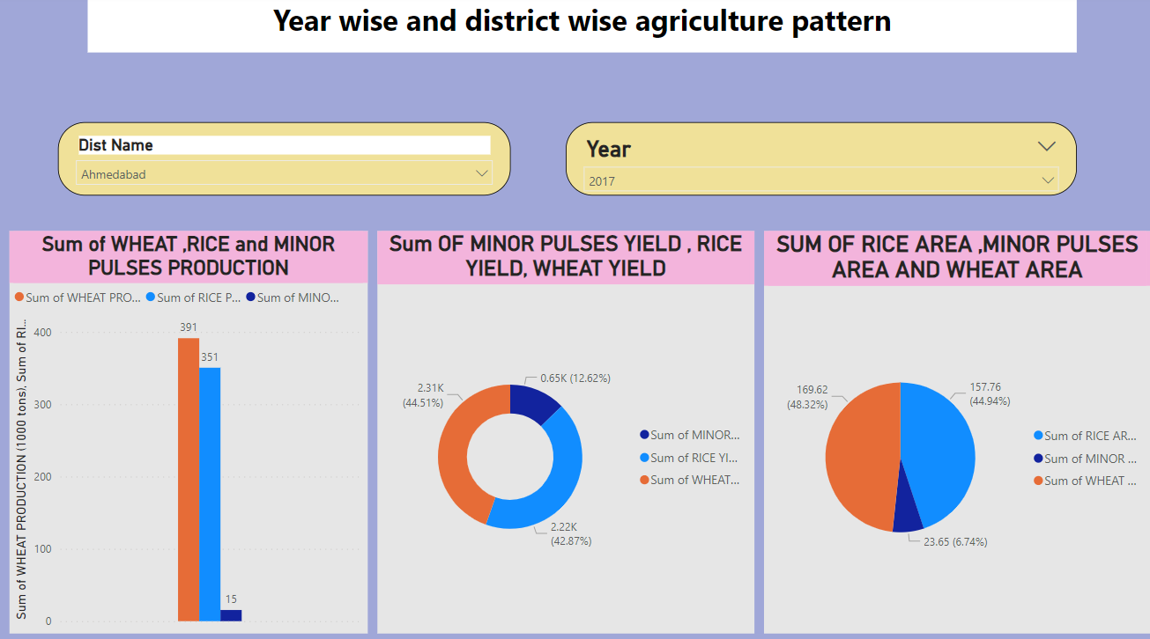
Problem statement
Year wise and district wise agriculture pattern

Slide 6
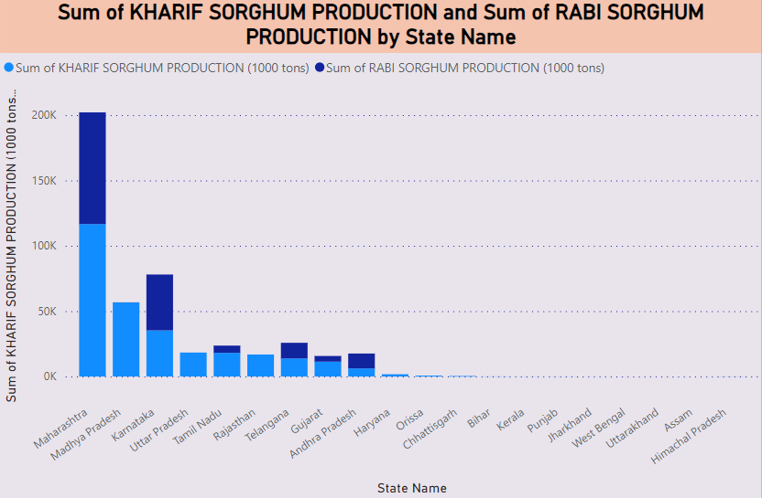
Seasonal patterns

Slide 7
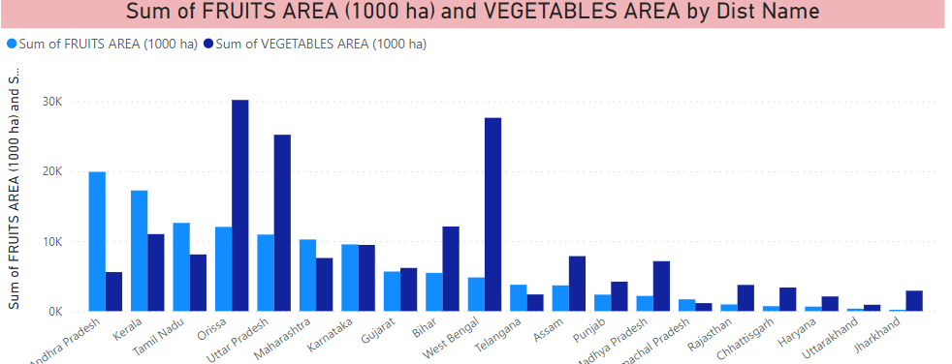
Fruits and vegetables analysis

Slide 8
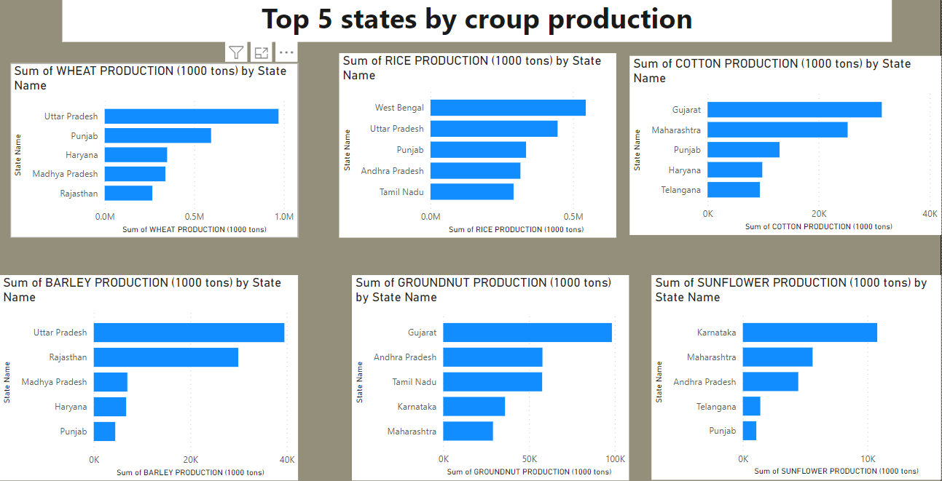
Top 5 stats by croup production

Slide 9
conclusion
The agriculture of a nation depends on several factors and its proper study is immensely useful. In this project, we have tried to get and organize agricultural data in a way in which it can be used for analysis. Visualization helps understanding the data better and hence, the data sets are visualized. Finding crops that have special changing patterns over the years like sudden decrease in production can help us understand the reasons behind them in a more specific way. We can also use these data to recommend new crops that can be grown in places which has the suitable weather and economy conditions.

Slide 10
Thank you
Khyati Trivedi
khyatinagar96@gmail.com

